Slide 1
Chapter 2
Learning by Example & Problem Solving

Slide 2
Part I
Learning by Example
【See Chap.2 in the textbook】

Slide 3
A Simple Example
Let’ begin with a quick introduction to C
Write a program in C to print the words:
Hello, World

Slide 4
I-1 The “Hello, World” Program
/*
* file: hello.c
* --------------
* This program prints the message “Hello, World.”
* on the screen. The program is taken from the
* classic C reference text “The C programming
* Language” by Brian Kernighan and Dennis Ritchie.
*/
#include <stdio.h>
#include “genlib.h”
main()
{
printf(“Hello, World.\n”);
}
program
comment
library inclusions
main program

Slide 5
I-2 A Program to Add Two Numbers
/*
* File: add2.c
* This program reads in two numbers, adds them together,
* and prints their sum.
*/
#include <stdio.h>
#include “genlib.h”
#include “simpio.h”
main()
{
int n1, n2, total;
printf(“This program adds two numbers.\n”);
printf(“1st number? ”);
n1 = GetInteger();
printf(“2nd number? ”);
n2 = GetInteger():
total = n1 + n2;
printf(“The total is %d.\n”, total);
}
This program adds two numbers.
1st number? 2
2nd number? 3
The total is 5.
variable declaration
assignment statement
input phase
assignment statement
computation phase
output phase

Slide 6
I-3 Perspective on the programming process
Reductionism（归约论）:
  learning from detail
Holism（整体论）:
  learning from the big picture

Slide 7
I-4 Data Types in C
A data type:
  A set of values, or domain:
  e.g. int (…-2, -1, 0, 1, 2…)
  A set of operations:
  e.g. add or divide

Slide 8
Floating-point data
Most common type of floating point number in C: double
#include <stdio.h>
#include “genlib.h”
#include “simpio.h”
main()
{
double n1, n2, total;
printf(“This program adds two floating-point numbers.\n”);
printf(“1st number? “);
n1 = GetReal();
Printf(“2nd number? “);
n2 = GetReal();
total = n1 + n2;
printf(“The total is %g\n”, total):
}

Slide 9
String data
Primitive elements of text data:
characters
A sequence of characters:
string (defined in “genlib.h”)
String declaration:
    string name;

Slide 10
String data
    #include <stdio.h>
    #include “genlib.h”
    #include “simpio.h”
    main()
    {
        string user;
        printf(“What is your name? “);
        user = GetLine();
        printf(“Hello, %s.\n”, user):
    }
What is your name? Eric
Hello, Eric.

Slide 11
I-5 Expressions
Expression: = term + operator
    n1 + n2
Term:
  A constant : 0 or 3.14159
  A variable : placeholders for data
  A function call: GetInteger()
  An expression in parentheses

Slide 12
Constants
Integer: 123, -123, 1000000
Floating-Point: 2.0, 2.9979E+8
String: “Hello, world.\n”

Slide 13
Variable
3 attributes: name, value, type
Naming rules:
  Start with a letter or ‘_’. uppercase and lowercase letters are different.
  Other characters in the name must be letters, digits, or ‘_’. (No space or other special characters)
  Key words like if, else, int, double, etc, are reserved
  Consider only the first 31 characters as significant
  Names should be understandable

Slide 14
Assignment Statement
SYNTAX for assignment statements
variable = expression;
where:
variable is the variable you wise to set
expression specifies the value
n2 = n1;
    int n1, n2;
string msg;
n1 = 42;
msg = “Welcome!”;
msg = “Aloha!”;
n1
n2
msg
42
Aloha!
42
Welcome!

Slide 15
Operators and operands
arithmetic operators: +, -, *, /
    x + 3
    (2 * x) + (3 * y)
unary operator: -x
binary operator: x-y

Slide 16
A program to convert a length in inches to its metric equivalent in centimeters
#include <stdio.h>
#include “genlib.h”
#include “simpio.h”
main()
{
double inch, cm;
printf(“This program converts inches to centimeters.\n”);
printf(“Length in inches? “);
inch = GetReal();
cm = inch * 2.54;
printf(“%g in = %g cm\n”, inch, cm):
}

Slide 17
Combining integers and floating-point numbers
int n;
  n+1 => int
  n+1.5 => double
Integer division
  9/4 => 2 (int)
  9.0/4, 9/4.0, 9.0/4.0 => 2.25(double)
%: computes a remainder , both operands must be of type int 9%4=1

Slide 18
Precedence
Rules:
  first applies any unary minus operators (a minus sign with no operand to its left)
  applies the multiplicative operators (*, /, and %). If two of these operators apply to the same operand, the leftmost one is performed first
  applies the additive operators (+ and -).
Example:
  Compute： 8 * ( 7 – 6 + 5 ) % ( 4 + 3 / 2 ) - 1
8 *
(7 – 6 + 5)
%
(4 + 3 / 2)
-1
=> 2

Slide 19
Type conversion
  Truncation:
    int n; n = 1.9999; (setting n to 1)
  Type cast:
    int num, den;
    double quotient;
    quotient = num/den; (throw away fraction)
    quotient = num/(double)den;
    quotient = (double)num/den;
(fraction part reserved)

Slide 20
Convert centimeters to feet and inches
#include <stdio.h>
#include "genlib.h"
#include "simpio.h"
main()
{
  double totalInches, cm, inch;
  int feet;
  printf("This program converts centimeters to feet and inches.\n");
  printf("Length in centimeters? ");
  cm = GetReal();
  totalInches = cm / 2.54;
  feet = totalInches/12;
  inch = totalInches - feet * 12;
  printf("%g cm = %d ft %g in\n", cm, feet, inch);
}

Slide 21
Part II
Problem Solving
【See Chap.3 & Chap 9.2 in the textbook】

Slide 22
II-1 Programming idioms and paradigms
programming idioms: a statement or group of statements in C
paradigm: a fragment of C code that shows the syntactic structure of a particular statement or idiom
Read-an-integer idiom
A paradigm
printf(“prompt string”);
variable = GetInteger();
printf(“1st number? “);
n1 = GetInteger();

Slide 23
Shorthand assignment idioms
An assignment statement: an active operation that explicitly stores the value of the expression on the right in the variable on the left
idiomatic shorthand:
balance = balance + deposit;
balance += deposit;
shorthand assignment operator
variable = variable op expression;
variable op= expression;

Slide 24
Increment and decrement operators
incrementing : Adding 1 to a variable
x++;
x += 1;
x = x + 1;
decrementing : subtracting 1 from a variable
y--;
y -= 1;
y = y – 1;

Slide 25

Problem
How to modify this program to add 10 or 100 or even 1000 numbers?
#include <stdio.h>
#include “genlib.h”
#include “simpio.h”
main()
{
int n1, n2, total;
printf(“This program adds two numbers.\n”);
printf(“1st number? “);
n1 = GetInteger();
printf(“2nd number? “);
n2 = GetInteger():
total = n1 + n2;
printf(“The total is %d.\n”, total);
}

Slide 26
II-2 Solving problems on a larger scale
Program variable declaration: int value, total;
For each input value:
  Request an integer value from user and store it in the variable value
  Add value to the running sum stored in the variable total
printf(“ ? “);
value = GetInteger();
total += value;
At this point, what we need to do is find some way to make the program above execute this set of statements 10 times.

Slide 27
II-2 Control statements
control statement: a statement that affects how other statement are executed.
The repeat-N-times idiom
for (i = 0; i < N; i++) {
statements to be repeated
}
control line
for (i = 0; i < 10; i++) {
printf(“ ? “);
value = GetInteger();
total += value;
}
body

Slide 28
Iteration and loops
Iteration: the process of repeating an operation
Loop: any portion of the program that is repeated through the action of a control statement such as the for statement
Cycle: A complete execution of the statements within the loop

Slide 29
Index variables
index variable
for (i = 0; i < N; i++)
The importance of initialization
initialization :Using an assignment statement to ensure that a variable has its proper initial value
Initialization (Very important!!!)
total = 0;
for(i = 0; i < 10; i++) {
printf(“ ? “);
value = GetInteger();
total += value;
}

Slide 30
Answer to the problem
/* File: add10.c
* This program adds a list of the number, printing
* the total at the end. Instead of reading the numbers
* into separate variables, this program reads in each
* number and adds it to a running total.
*/
#include <stdio.h>
#include “genlib.h”
#include “simpio.h”
main()
{
int i, value, total;
printf(“This program adds a list of ten numbers.\n”);
total = 0;
for (i = 0; i < 10; i++) {
printf(“ ? “);
value = GetInteger();
total += value;
}
printf(“The total is %d\n”, total);
}

Slide 31
The read-until-sentinel idiom
while (TRUE) {
prompt user and read in a value
if (value == sentinel) break;
rest of body
}
How to solve the problem use this idiom?

Slide 32
Another answer to the problem
/* File: addlist.c
* This program adds a list of number. The end of the
* input is indicated by entering 0 as a sentinel value.
*/
#include <stdio.h>
#include “genlib.h”
#include “simpio.h”
main()
{
int i, value, total;
printf(“This program adds a list of numbers.\n”);
printf(“Signal end of list with a 0.\n”);
total = 0;
while (TRUE) {
printf(“ ? “);
value = GetInteger();
if (value == 0) break;
total += value;
}
printf(“The total is %d\n”, total);
}

Slide 33
Building a more practical application
A program to add a column of figures is not likely to sell a million copies or turn you into the next software billionaire
How would the program change if you were asked to rewrite it as a checkbook balancer?

Slide 34
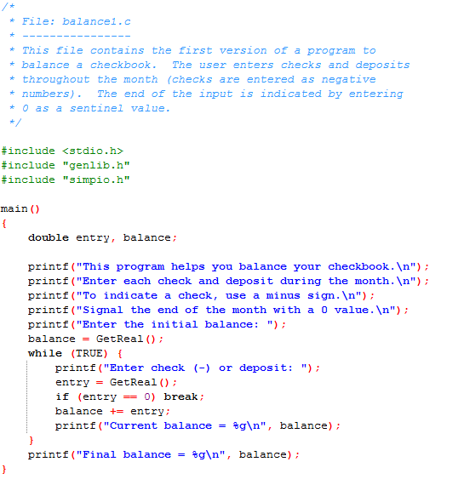

Slide 35
Conditional execution and the if statement
conditional execution: the program to execute a statement only if some condition applies or to choose between two alternative courses of action depending on the result of some test.
if (conditional-test) {
…statements executed if the test is true…
}
or
if (conditional-test) {
…statement executed if the test is true…
} else
…statements executed if the test is false…
}

Slide 36
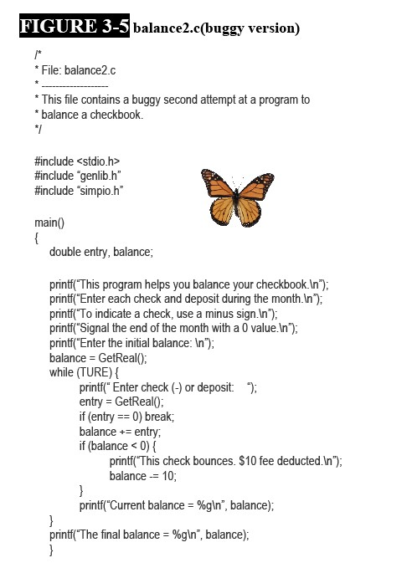

II-4 An exercise in debugging
Where is the bug?
Bug here!!!

Slide 37
II-5 Formatted output
The printf function is one of C’s most distinctive features
A call to the printf function has the following paradigmatic form:
printf(“control strring”, expression1, expression2,…);
printf(“control string”);

Slide 38
Format codes for printf
printf : can display values in a variety of formats (the f at the end of printf stands for formatted).
Format code :The combination of the percent sign and the key letter . ( %g , %s)
The most common format codes for printf are listed below
%d: Decimal integer
%f : Floating-point
%e: Exponential
%g: General
%s : String
%%: Percent sign

Slide 39
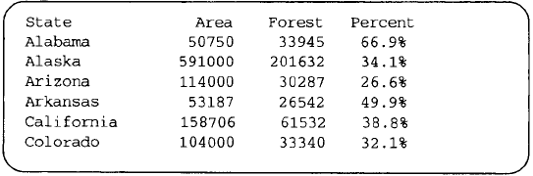
Controlling spacing, alignment, and precision
Field width: The number of character positions allocated to the entries in a particular column
alignment :Line the numbers up so they all end or begin at the same position
Left alignment
Field width：6 char
Precision
How to print like this?

Slide 40
Answer to the problem
printf(“%-14.14s %6d %6d %4.1f%%\n”,state, totalArea,forestArea, percent);
%-14.14s:The minus sign specifies left alignment; the 14 indicates the width of the field and a precision specification indicating that only the first 14 characters should be printed.
%6d：a right-aligned numeric field six digits wide
%4.1f：the field width is four, two digits before the decimal point, the decimal point itself, and one digit after the decimal point

Slide 41
II-6 Crafting a program
Programming style
Several stylistic guidelines that you can follow to help you write better programs
Use comments to tell your readers what they need to know
Use indentation to mark the various levels of program control
Use meaningful names
Develop a convention for variable names that helps readers identify their function
Use standard idioms and conventions when appropriate
Avoid unnecessary complexity

Slide 42
Designing for change
make programs easier to modify by designing them to accommodate change.
The #define mechanism
The best tool available in C for centralizing editing changes is the #define construct
#define symbol value
symbol represents a name that follows the same rules used for variables
value represents a C constant

Slide 43
The #define mechanism example
#define bouncedCheckFee 10.00
if (entry < 0 && balance <0){
printf(“This check bounces. $%.2f fee
deducted.\n”, bouncedCheckFee);
balance -= bouncedCheckFee;
}

Slide 44
The final version of the checkbook-balancing program
/*
* File: balance4.c
* -------------------
* This file contains the version of a program to
* balance a checkbook.
*/
#include <stdio.h>
#include “genlib.h”
#include “simpio.h”
/*
* Constant: BouncedCheckFee
* ---------------------------------------
* To change the charge assessed for bounced checks, change
* the definition of this constant. The constant must be a
* floating-point value (i.e., must contain a decimal point).
*/
#define BouncedCheckFee 10.00
Continue…next page

Slide 45
/* Main program */
main()
{
double entry, balance;
printf(“This program helps you balance your checkbook.\n”);
printf(“Enter each check and deposit during the month.\n”);
printf(“To indicate a check, use a minus sign.\n”);
printf(“Signal the end of the month with a 0 value.\n”);
printf(“Enter the initial balance: \n”);
balance = GetReal();
while (TURE) {
printf(“ Enter check (-) or deposit: “);
entry = GetReal();
if (entry == 0) break;
balance += entry;
if (balance < 0 && entry < 0) {
printf(“This check bounces. $%.2f fee deducted.\n”,BouncedCheckFee);
balance -= BouncedCheckFee;
}
printf(“Current balance = %.2f\n”, balance);
}
printf(“Final balance = %.2f\n”, balance);
}

Slide 46
II-7 Characters
Fundamental type: “atoms” of text data
A built-in enumeration type
Data type: char
  Domain: set of symbols that can be displayed on the screen or typed on the keyboard
  Operations: similar to integers

Slide 47
The ASCII code
Character code: ‘A’→1, ‘B’→2, …
Sharing is difficult
Standard for character representation： ASCII (American Standard Code for Information Inter-change)
Character constants: ‘A’, ‘9’, ‘\n’, ‘*’

Slide 48
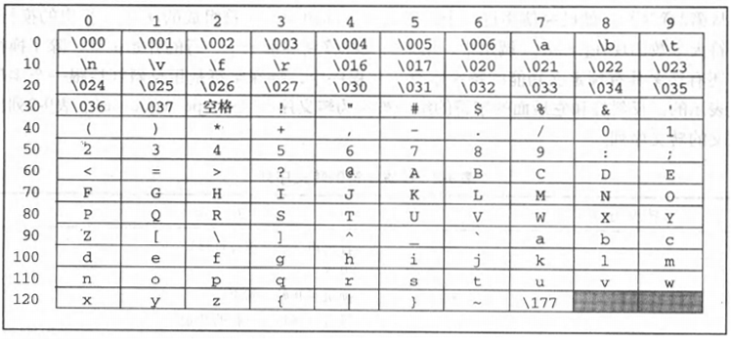
The ASCII code

Slide 49
Important properties of the ASCII coding scheme
Codes for ‘0’ through ‘9’ are consecutive
Letters in the alphabet:
  uppercase letters (‘A’-’Z’)
  lowercase letters (‘a’-’z’)
  Within each range the ASCII values are consecutive

Slide 50
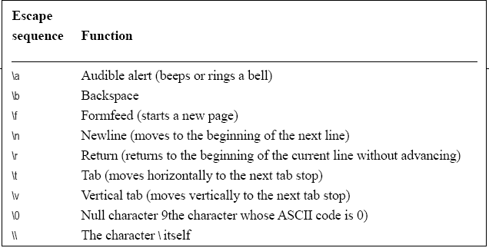
Special Characters
Representation: backslash + letter/numeric value ( ‘\n’, ’\t’, ’\0’ )
  printf (“\”Bother,\” said Pooh.\n”);
“Bother,” said Pooh.

Slide 51
Special Characters
ANY characters can be represented as ‘\ASCII-code’ , where ASCII-code is the ASCII code of the character.
ASCII-code can only be in octal （八进制）or hexadecimal（十六进制）.
Examples：
A （ASCII code is 65 in decimal）：‘A’ , ‘\101’ ‘\x41’
In fact:
  ‘A’ ⬄ 65
  ‘\0’ ⬄ 0

Slide 52
Character arithmetic
Adding an integer to a character
‘0’+n→character code of the nth digit (0<=n<=9)
Subtracting an integer from a character
‘z’-2→’x’
Subtracting one character from another
‘z’-’Z’→32
Comparing two characters against each other
c1<c2

Slide 53


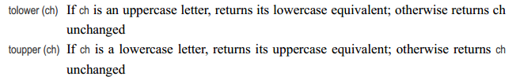
The ctype.h interface
Library for determining the type of a character
Conversion functions

Slide 54
Control statements involving characters
for (ch = 'A'; ch <= 'Z'; ch++)
Judge whether ch is a vowel
bool IsVowel (char ch)
{
switch (tolower(ch)) {
case 'a': case 'e': case 'i': case 'o': case 'u':
return (TRUE);
default:
return (FALSE);
}
}

Slide 55
Character input and output
getchar(),putchar()
main()
{
char ch;
while (TRUE) {
ch = getchar();
ch = toupper(ch);
putchar(ch);
if (ch == '\n') break;
}
}

Slide 56
Character input and output
primtf： %c
main()
{
char ch;
printf (“The English vowels are:”);
for (ch = ‘A’; ch <= ‘Z’; ch++) {
if (IsVowel (ch)) printf (“ %c”, ch);
}
printf (“\n”);
}

Slide 57
Homeworks for Chapter 2:
Pp53-54 in the textbook
  Review Questions: 2、13、14、15、17、19、22
You can write down your answers in English or Chinese.

Slide 58
The End

